Slide 1
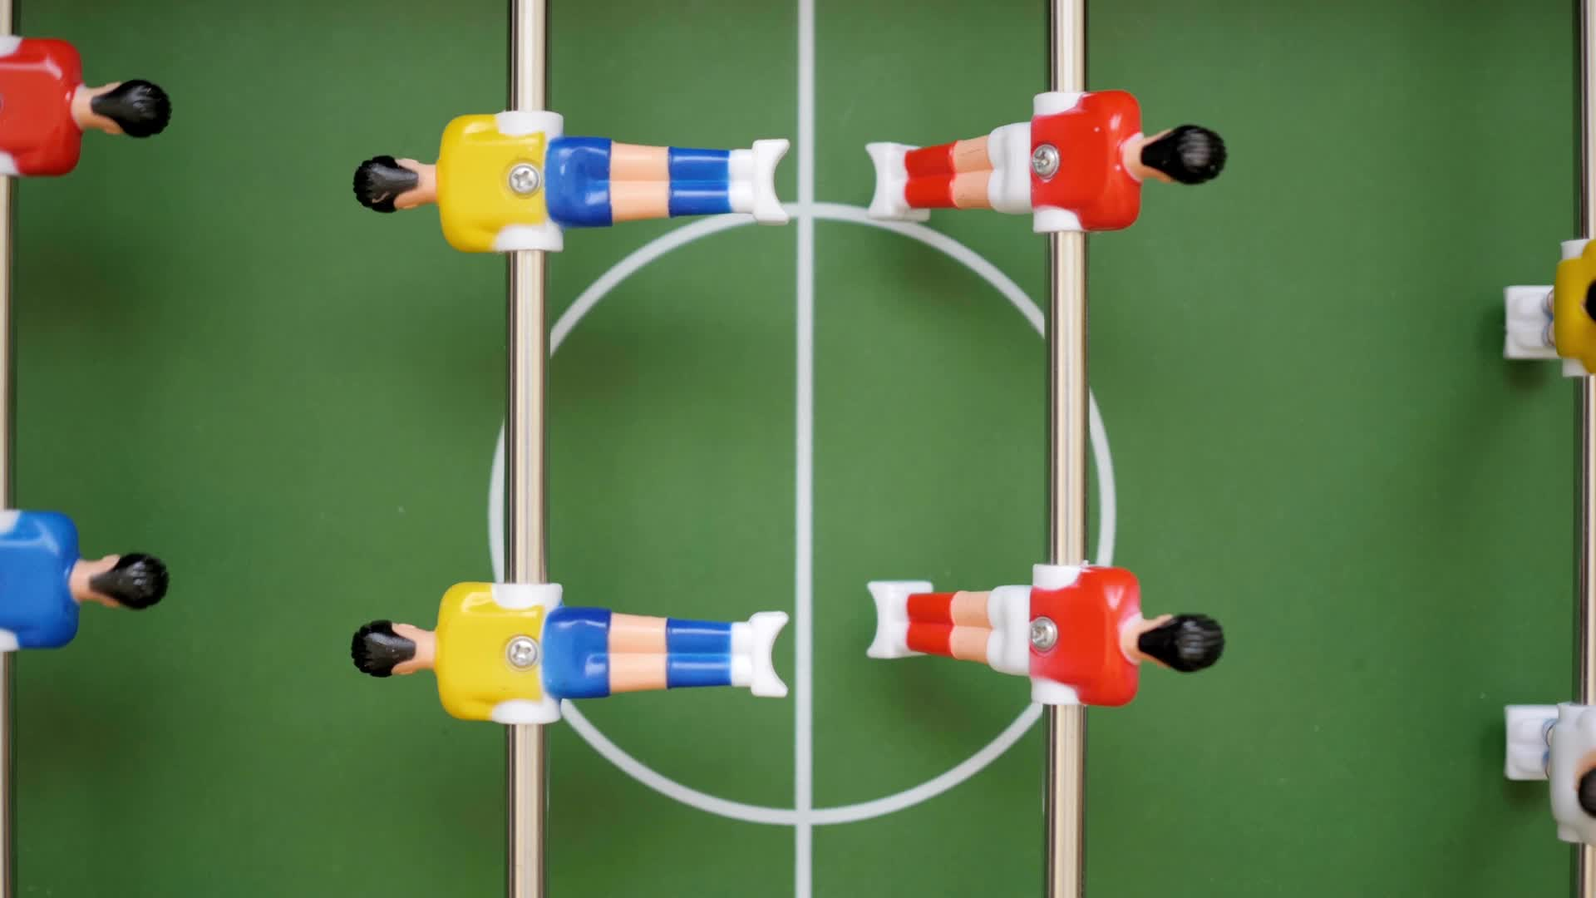
Predicting results in soccer games
Team 6:
Ndubuisi Chibuogwu
Hassan Sarr
Javier Berdejo

Slide 2

Introduction
Topic: predicting soccer results (Wins/Losses/Draws) from 2018-19 English Premier League season.
Motivation: we believe predictive analytics can draw useful insights.
Goals: we want to be able to build solid predictions based on the teams’ match statistics and performances.

Slide 3
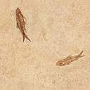


Data Sources
Thousands of datasets from over 1,000+ soccer leagues
CSV files for teams, matches, leagues and players
The Matches dataset has 380 records (10 games per week) and 64 attributes.
4 categorical features
60 numerical features from aspects of the game.

Slide 4

DATA ANALYSIS

Slide 5
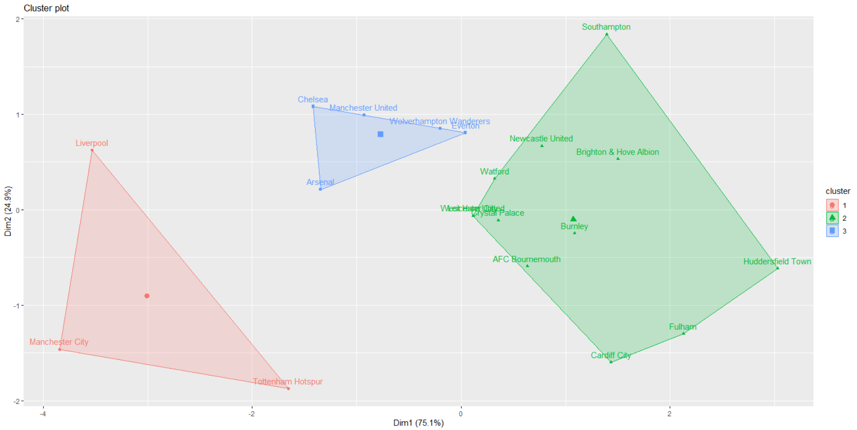
Are we working with supervised or unsupervised data?

Slide 6
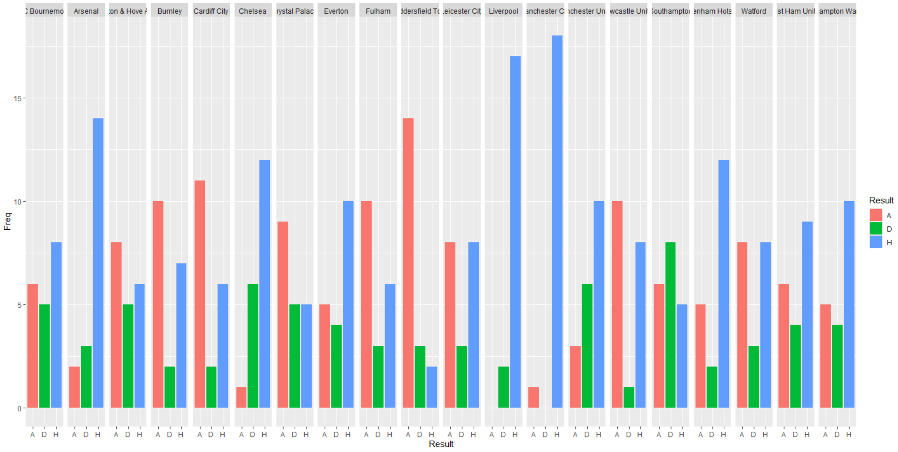
How can we classify Win and Loses based on match location?

Slide 7
PREDICTION APPROACH
CLASSIFICATION: kNN and Boosting
REGRESSION: POISSON

Slide 8
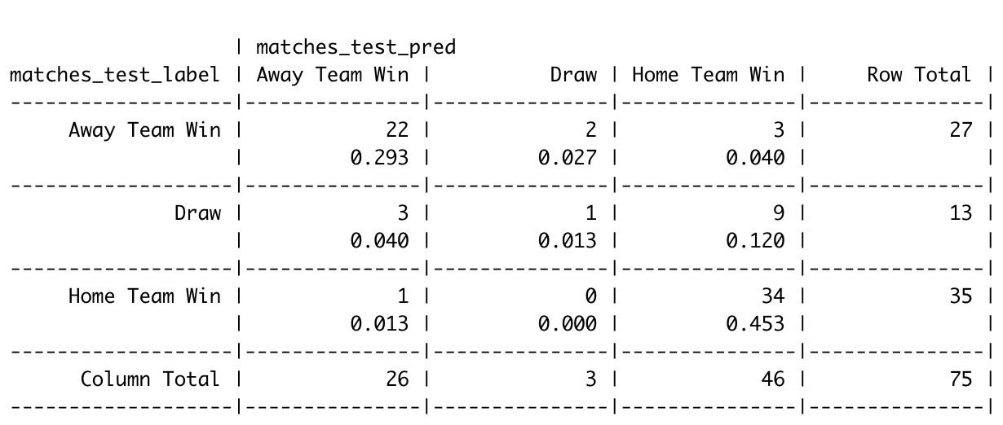
K-NN
Apply K-NN using K value square root of the number of records
Evaluate using crosstable
Draw is correctly predicted only one time

Slide 9
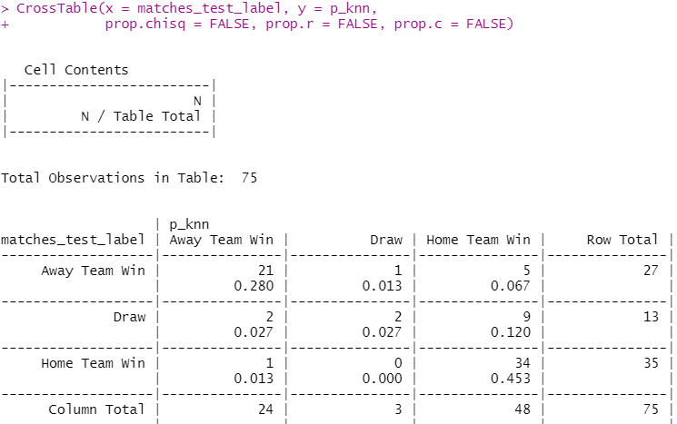
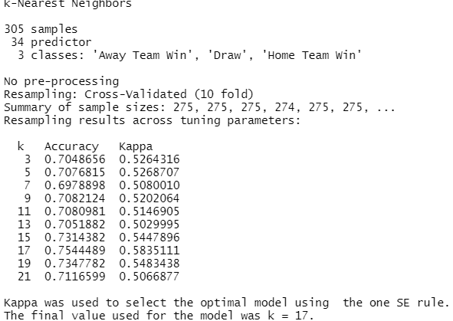
K-NN
With KNN we achieved a 75.5% accuracy with a Kappa metric of 0.5835111 and a K-value = 17.
The model had a total of 13 wrong predictions, with a 24.5% error rate. “DRAWs” is 61.1% of the predicted errors.
High error in DRAW predictions down to a class imbalance as can be seen from the CrossTable.
Draw has 17.3% occurrence rate, Home_Win 46.7% and Away_Win 36%.

Slide 10
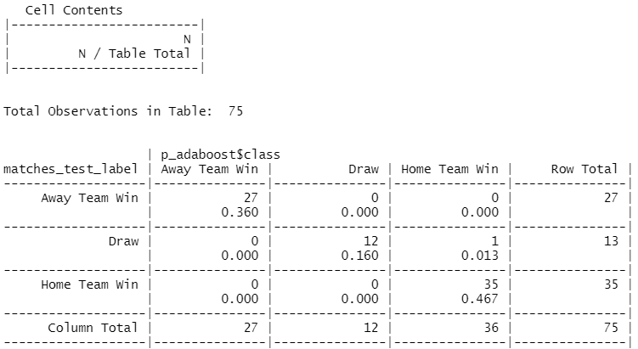
BOOSTING
Using boosting we achieved a 92.3% accuracy in “DRAW” predictions.
98.7% model accuracy, up from 75.5%
1.3% error rate down from 24.5%

Slide 11
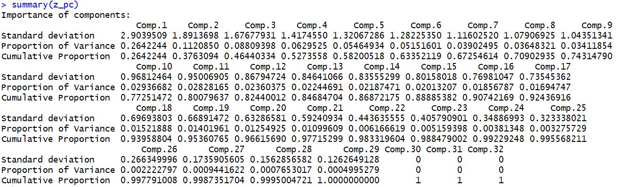
POISSON REGRESSION DIMENSIONALITY REDUCTION: PCA
16 Principal components explain 90% of variance

Slide 12
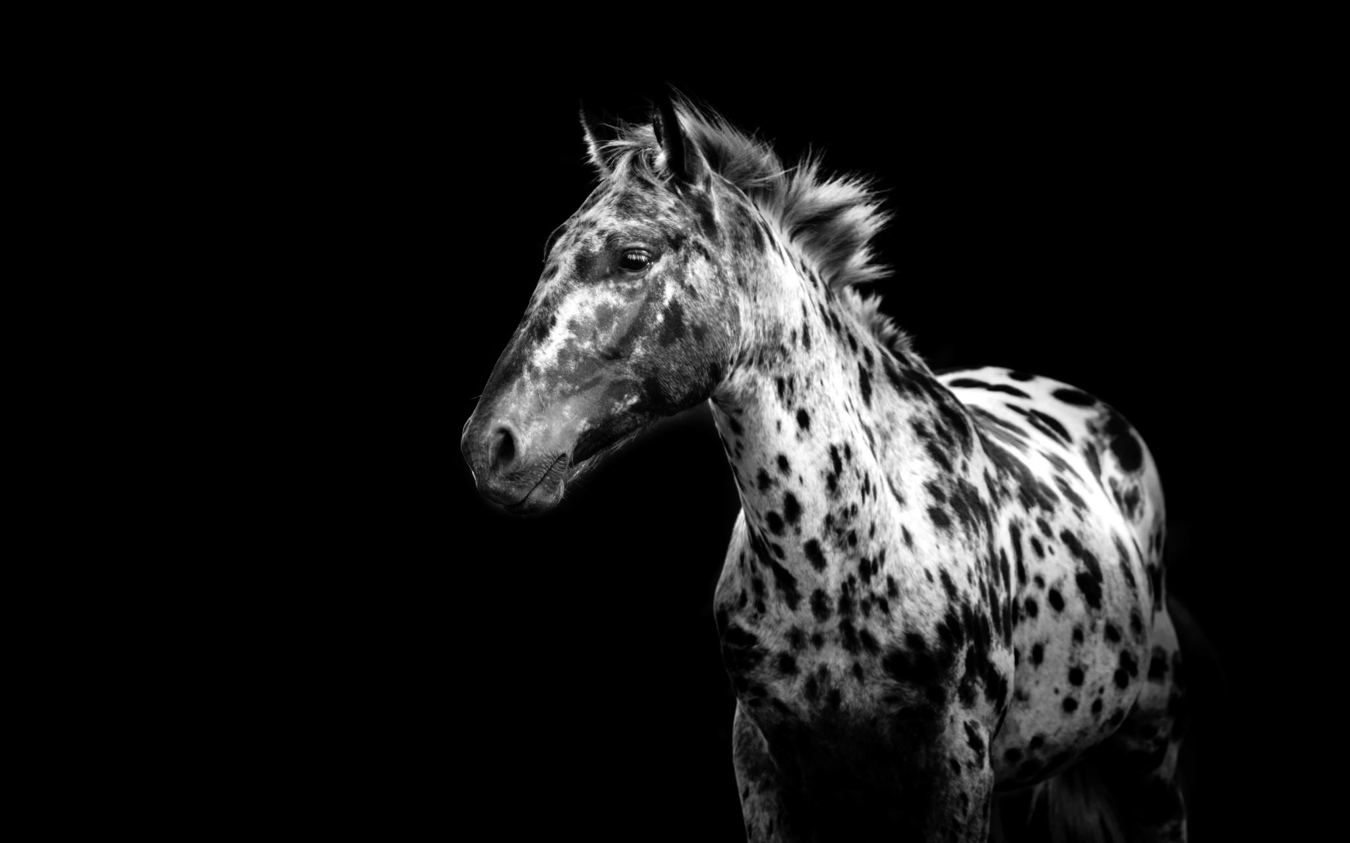
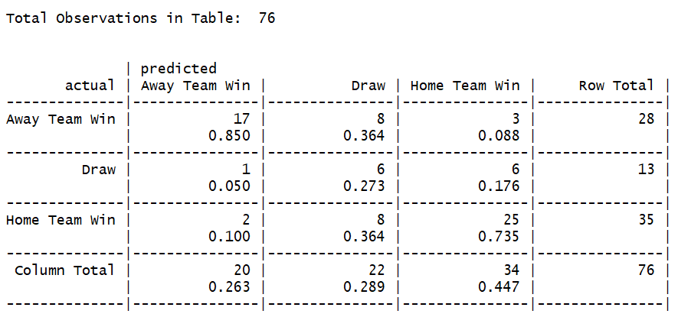
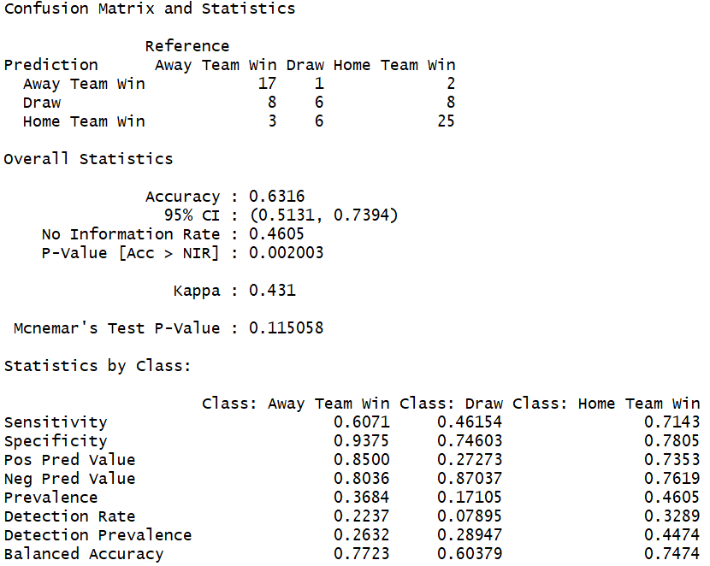
POISSON WITH PCA
With Poisson we achieved a 63.16% accuracy with a Kappa value of 0.431

Slide 13
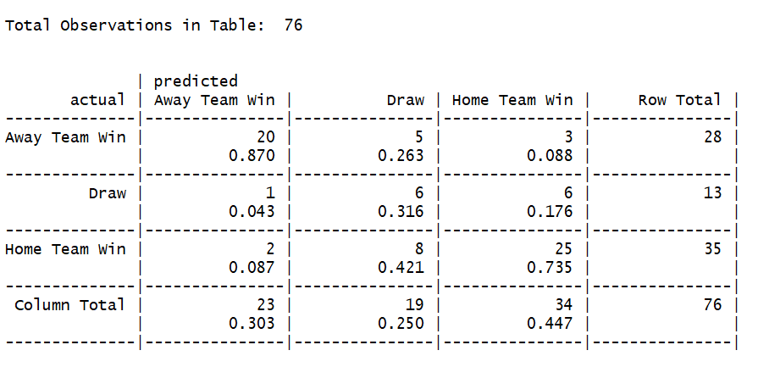
POISSON WITHout pca

Slide 14

FUTURE WORK
Increase amount of data
Further exploration in the unsupervised learning aspect
Improve Regression model
- Find and apply interactions
- Fix model complexity (Lasso, Ridge)

